Slide 1
SDLC- software design lifecycle
By-Naman bangari
GEHU 6TH SEM
Dehradun

Slide 2

Introduction
Title: Understanding Software Development Life Cycle (SDLC)
Content:
Definition: Structured approach to software development.
Purpose: Ensures systematic, efficient, and customer-focused development.
Key Models: Waterfall, Agile, Spiral, V-Model.

Slide 3

Phases of SDLC
Title: Phases of Software Development Life Cycle
Content:
Planning: Define scope, objectives, feasibility.
Requirements Analysis: Gather detailed requirements.
Design: Create system architecture and detailed designs.
Implementation: Write the actual source code.
Testing: Verify and validate the software.
Deployment: Install and configure the software.
Maintenance: Ongoing support and updates.

Slide 4
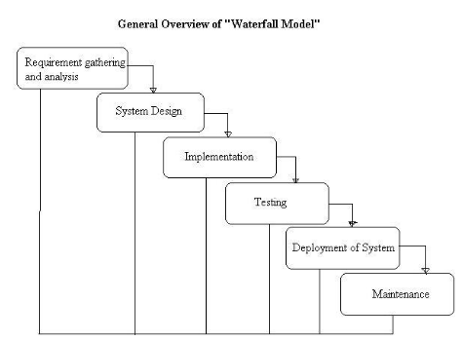
Waterfall Model
Description: Linear, sequential approach.
Pros:
Simple and easy to understand.
Clear project milestones.
Cons:
Inflexible to changes.
Late discovery of issues.

Slide 5
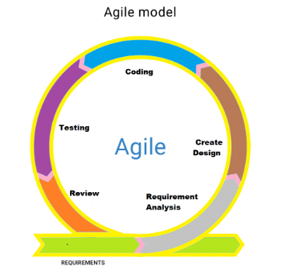
Agile Model
Description: Iterative, incremental approach with sprints.
Pros:
Adaptable to changes.
Frequent delivery enhances customer satisfaction.
Cons:
Requires active user involvement.
Challenging without experienced teams.

Slide 6

Why Understanding SDLC is Crucial Content: Structured Development: Reduces risks, improves efficiency. Better Project Management: Enhances planning, execution, monitoring. Quality Assurance: Ensures high-quality software through rigorous testing. Risk Management: Identifies and mitigates risks early. Stakeholder Communication: Improves communication about progress and requirements. Adaptability: Facilitates choosing the right model for different projects.

Slide 7
Thank you

